Slide 1



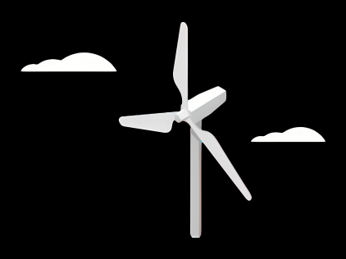
Gearbox, Brake, Coupling
Group Members :
Nehang Jitendra Joshi
Santo Mazumder
Md Razaul Karim Rahat
Arham Memon
Week number : 01
Date: 23/09/2025
Supervisor: Prof. Peter Quell

Slide 2
Objectives
Design of the Gearbox
Selection of Brake system
Design of Coupling

Slide 3
Gearbox
Main Objective:
Introduction
Research and market analysis
Standards and guidelines
Dimensioning of gears
Drawings
Calculation

Slide 4
Gearbox
Research on relevant standards and guidelines
IEC 61400-1:2019, Wind energy generation systems —Part 1: Design requirements
• IEC 61400-4:2012, Wind turbines —Part 4: Design requirements for wind turbine gearboxes
• ISO 6336-2:2019, Calculation of load capacity of spur and helical gears —Part 2: Calculation of surface durability (pitting)
• ISO 6336-3:2019, Calculation of load capacity of spur and helical gears —Part 3: Calculation of tooth bending strength
• ISO/TS 6336-4:2019, Calculation of load capacity of spur and helical gears —Part 4: Calculation of tooth flank fracture load capacity
• VDMA Specification 23903, Basic design requirements for plain bearings in main gearboxes of wind turbines
• VDMA Specification 23904, Reliability assessment for wind energy gearboxes

Slide 5
Gearbox
Semi-integrated design (so-called 3-point-suspension) Company in Germany which is using this kind of concept. a. Senvion b. Vestas c. Siemens d. Nordex e. GE
• Why ?
rotor bearing system is partly integrated in the gearbox.
The fixed bearing is connected to the machine bed, the floating bearing is part of the gearbox.
rotor loads (forces and moments) are transferred through the housing of the gearbox into the machine bed. separated 2nd bearing housing is not required anymore(as per our decision this is the main advantage of this drive train system using for Syria project 2025-26 (But still needs to research)……………………

Slide 6







Gearbox
Suppliers in the market:

Slide 7
Rotor Brake
Main Objective:
Introduction
Research and market analysis
Standards and guidelines
Dimensioning of brake
Drawings
Calculation

Slide 8
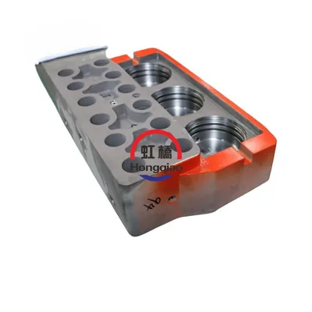
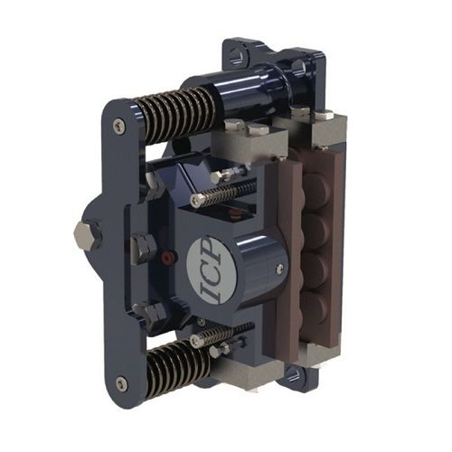
Rotor Brake
Fixed caliper brake (disk brake) is a typical hydraulic service brake used on the low torque side. All features of these hydraulic brakes are designed to operate reliably under adverse ambient conditions while generating low operating expenses.
Floating Caliper Design: The ability of the caliper to slide on the guide pins is crucial for ensuring proper and even braking force application, even if the rotor is slightly misaligned. This floating action also helps to distribute the braking force evenly across the brake pad, reducing wear and tear.
Applications in Wind Turbines: Rotor brakes (also known as fast speed dynamic brakes) are used to control over-speed conditions, preventing the turbine blades from rotating too fast in emergency situations or during parking. They can be mounted on either the low-speed shaft (rotor) or the high-speed shaft (generator). Floating caliper brakes are particularly useful in wind turbines due to their compact design and self-aligning properties, especially in applications where space is limited. They are also used in yaw brakes, which hold the nacelle (the housing at the top of the tower that contains the generator and other components) in a fixed position.

Slide 9


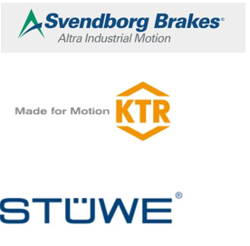
Brake system
Suppliers in the market:
ICP WIND
Svendborg Brakes
KTR
Stuwe

Slide 10
Coupling
Main Objective:
Introduction
Research and market analysis
Standards and guidelines
Dimensioning of coupling
Drawings
Calculation
Pros
Control and Safety
Reduced Gearbox Stress
Cons
Energy Loss
High Cost
Main Objectives:
To handle high torque, Minimize shock loads, and compensate misalignments between the rotor shaft and the gear box

Slide 11
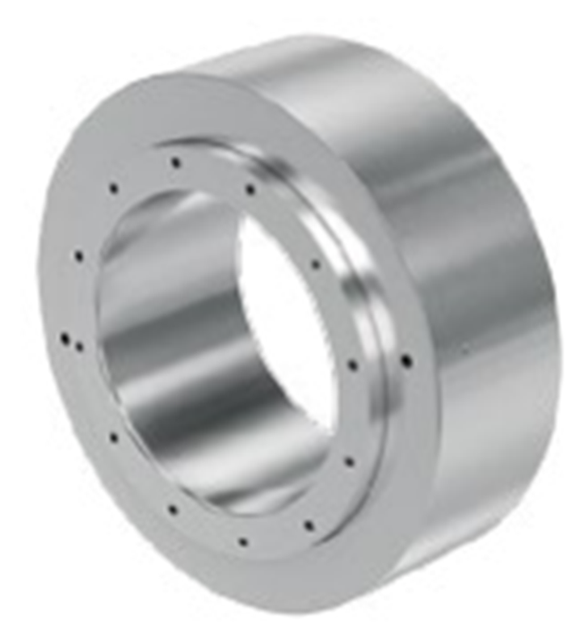

Jaure
JHC couplings
Jaure hydraulic shrink coupling
Easier installation
Can withstand high shock loads
Leakage risk
High pressure oil pump system is needed
Source: https://www.regalrexnord.com/brands/jaure/wind-power-drives

Slide 12
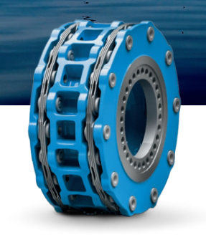
Flender
ARPEX GIGA wind coupling
This coupling can transmit torques of up to 12 MNm.
maintenance-free
compensate for axial, angular and radial misalignments.
A lot of Mechanical components
Source: https://www.flender.com/Produkte/Kupplungen/ARPEX-Windkupplungen/p/ATN09001

Slide 13
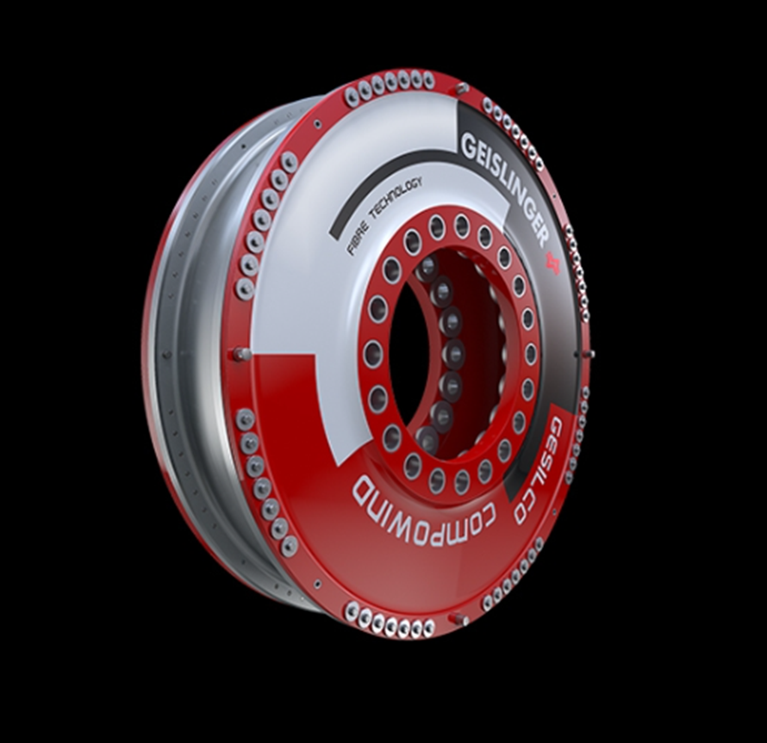
Geislinger
COMPOWIND Coupling
An innovative concept of fatigue-resistant and maintenance-free fiber composite membranes. With more than 90% reduction of rotor non-torque loads.
Fatigue-resistant
Maintenance-free
No aging, no wear, resistant to heat, frost, and saltwater
Diameters up to 3.5 m
Weight-saving design
Long life cycle
Source: https://www.geislinger.com/en/products/product/compowind-coupling/

Slide 14
Got some idea about from the internet and some website that is Winenergy group of company which origin of the German possible to provide in Syria because they have large production of gearbox which can gives good amount of work output and higher generation rates.
Enercon company is also leading for supplies in Syrian region.
ZF wind power Antwerpen also who is responsible to provide in this country
ZF wind power and giants company like Siemens and flander 40-50% stockholder for this project for suppliers.
( Above companies are located in European region mostly are capable enough)
Goldwind and Dongfang is also could become leading for suppliers of gearbox,brake,coupling ( Asian region and these companies located in china )
Research on previous year documents and got information about gearbox,brake,coupling
Research on appropriate drive train concept and gearbox
Research on standards and guild line and benchmarks for gearbox,brake,coupling
Research on Syrian market and know about suppliers

Slide 15
Bibliography
https://www.twiflex.com/en/newsroom/2016/02/is-caliper-brake-solutions-for-wind-turbines
https://antec-group.com/wp-content/uploads/2021/12/Catalogo-Wind-2022.pdf
https://www.twiflex.com/en/newsroom/2016/02/is-caliper-brake-solutions-for-wind-turbines
https://www.windsourcing.com/en/spare-parts-and-repair-material/brakes/brake-calipers/
https://www.ktr.com/de/en/products/brake-systems/
https://www.zf.com/products/en/wind/home/wind.html#:~:text=Empowering%20a%20Sustainable%20Future%20Together&text=ZF%20Wind%20Power%20develops%2C%20together,future%20together%20with%20our%20partners.
https://www.flender.com/en/branchesAndApplications/winergy#:~:text=Two%20powerful%20brands%20%2D%20one%20company,wind%20for%20a%20better%20future.

